Slide 1
BLEED FOR SPEED
Rapid Prototyping with Django
Rob Spectre, Director of Devangelism
@dN0t – rspectre@twilio.com

Slide 2
A LITTLE HISTORY

Slide 3
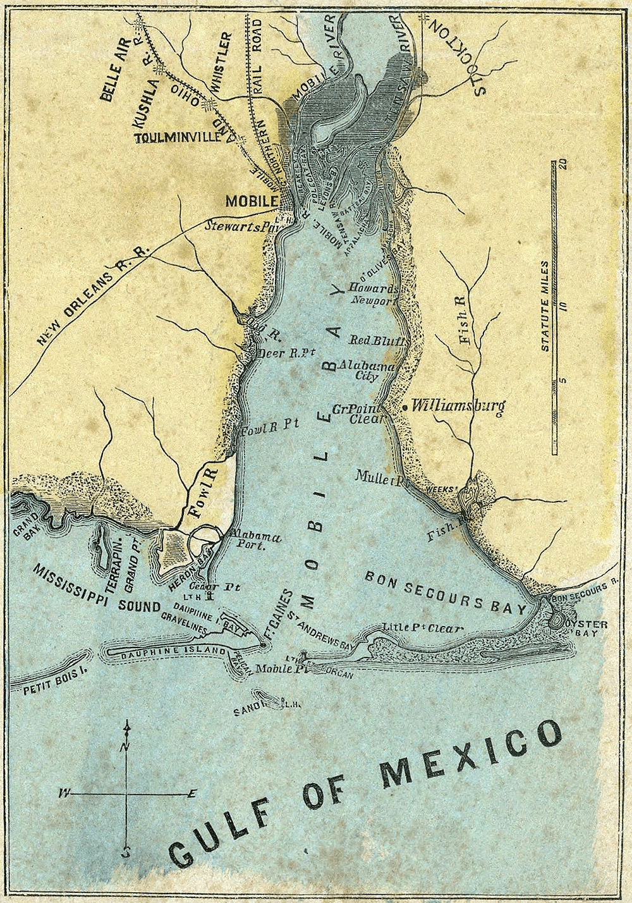
MOBILE BAY

Slide 4
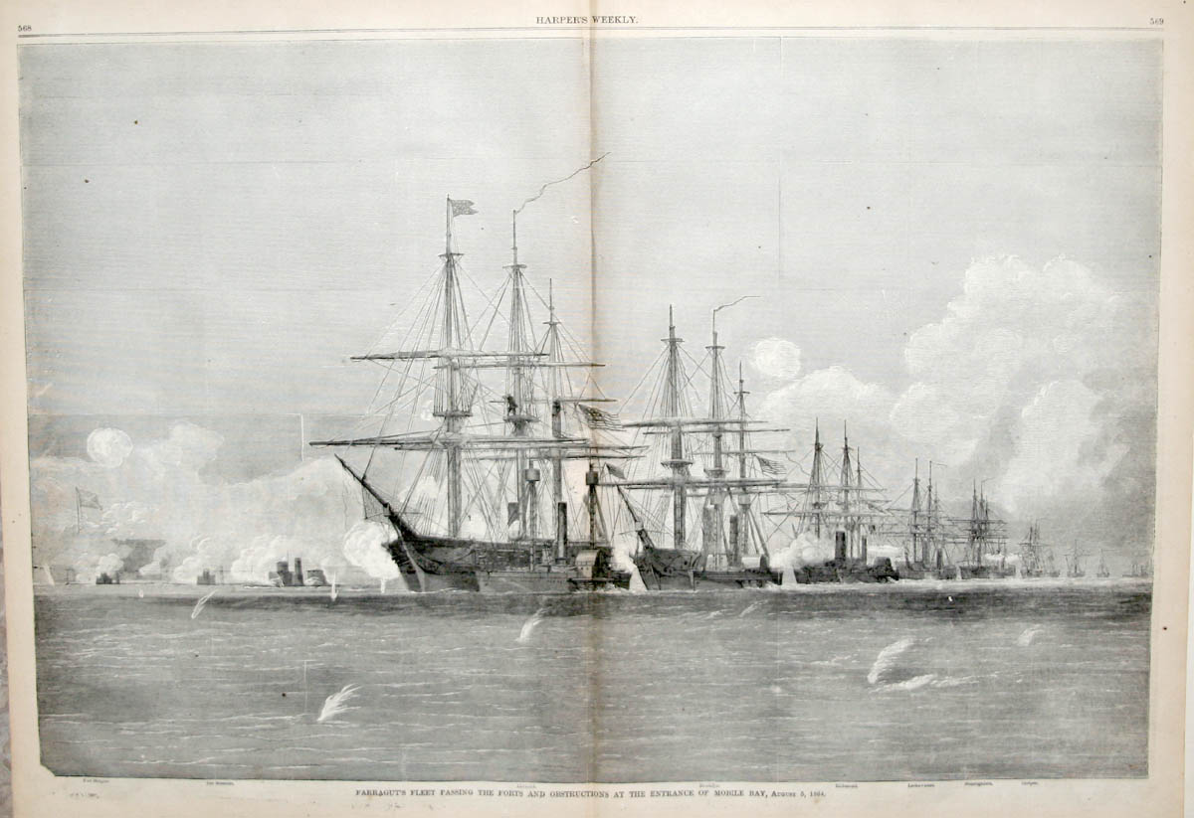
FOR REAL THEY HAD BOATS

Slide 5
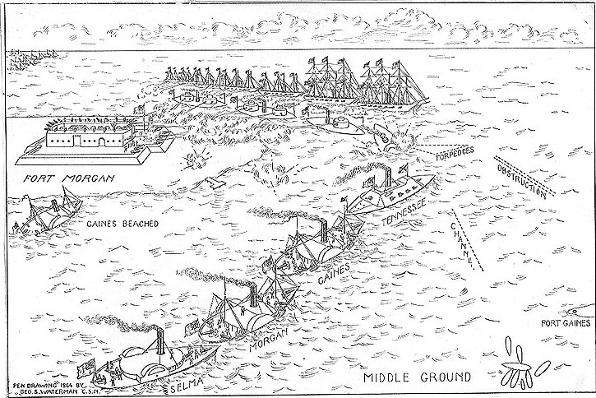
A SIMPLE JOB

Slide 6

WHOOPSIE DOODLE

Slide 7
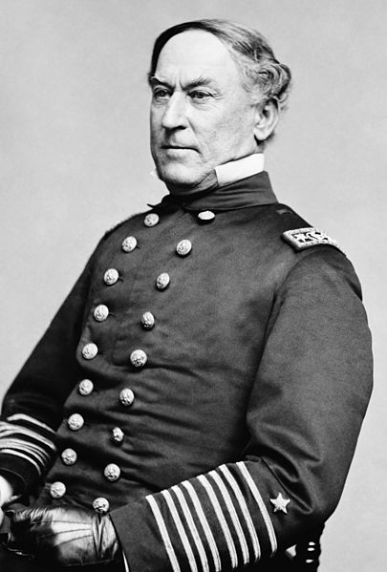
FRUMPY AND GRUMPY

Slide 8

PORKCHOP SANDWICHES

Slide 9

LISTEN TO GRANDDAD

Slide 10

PWN3T

Slide 11

WHAT'S YOUR POINT?

Slide 12
O HAI

Slide 13

RING A DING

Slide 14
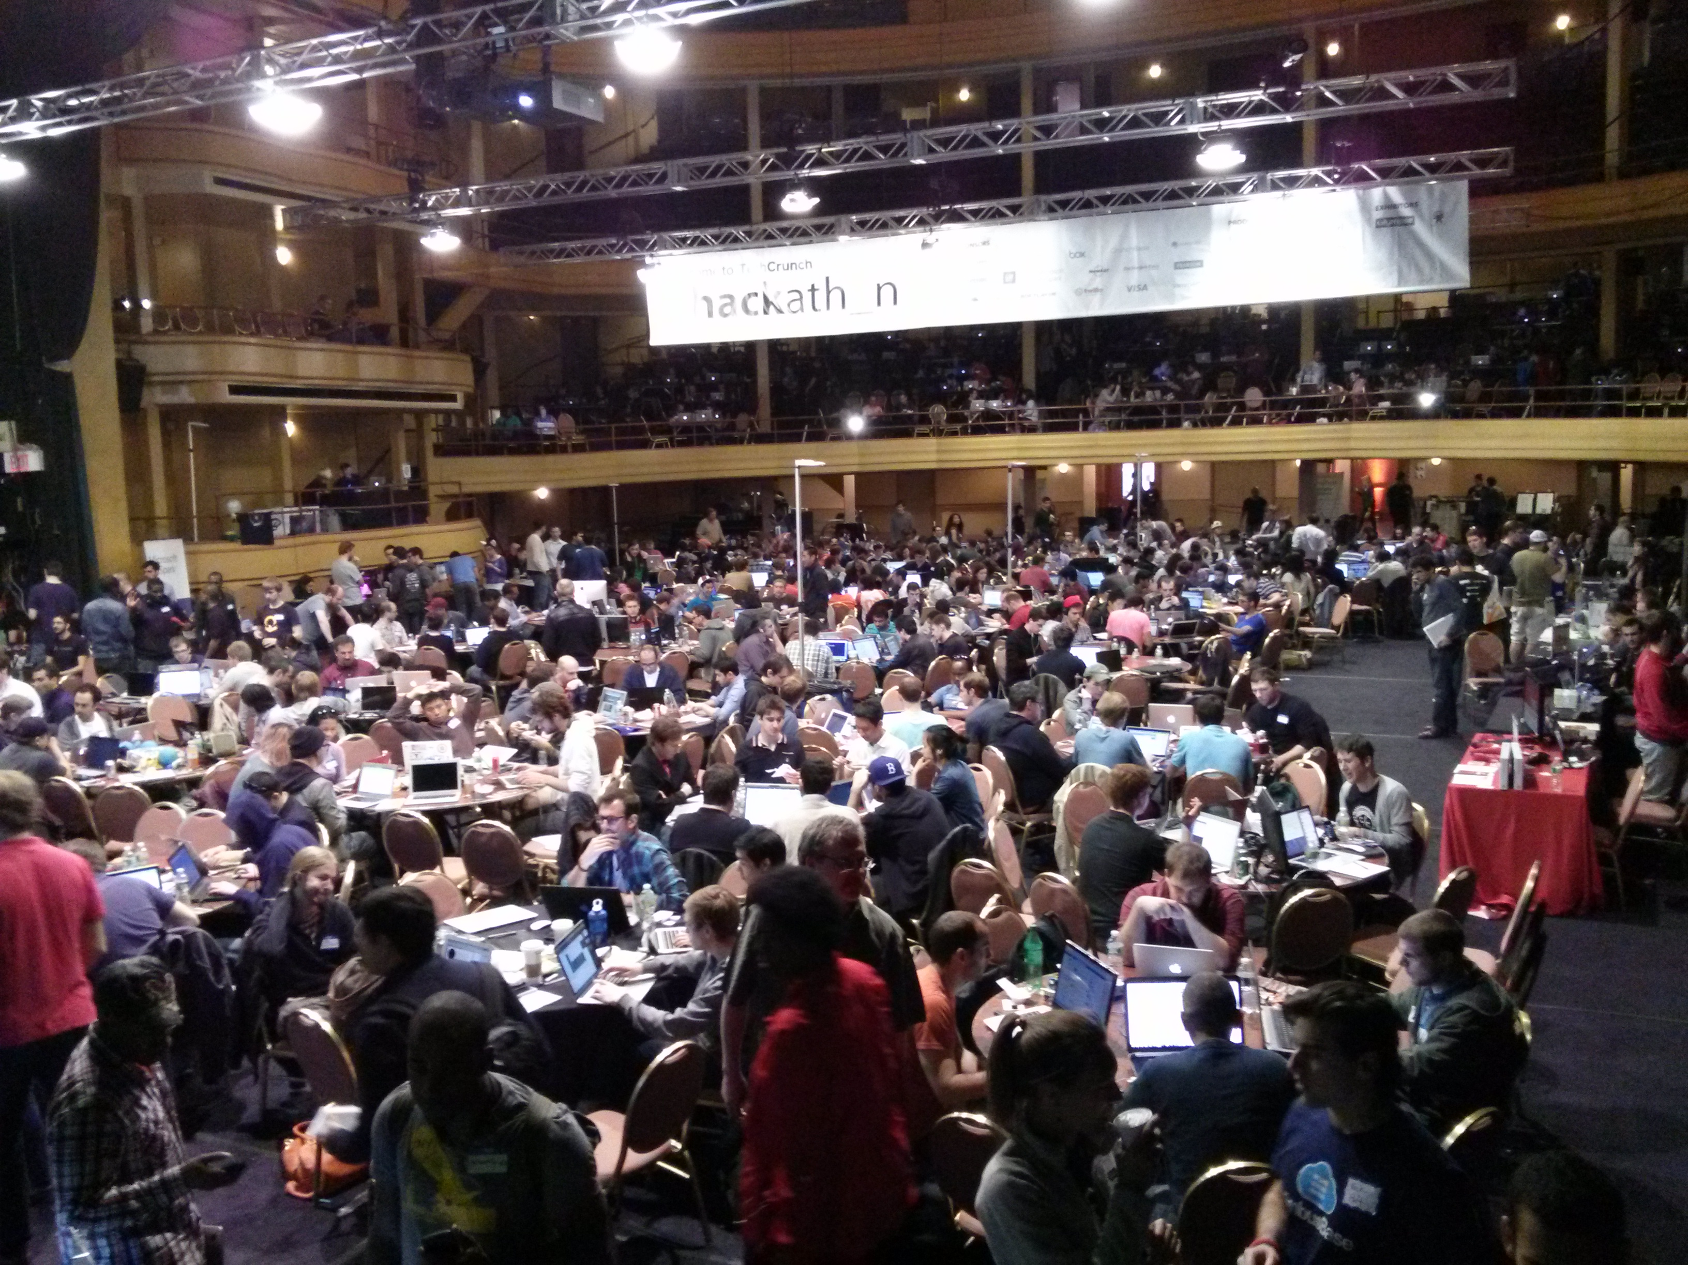
WELCOME HOME

Slide 15

24 HOUR PROTOTYPE

Slide 16
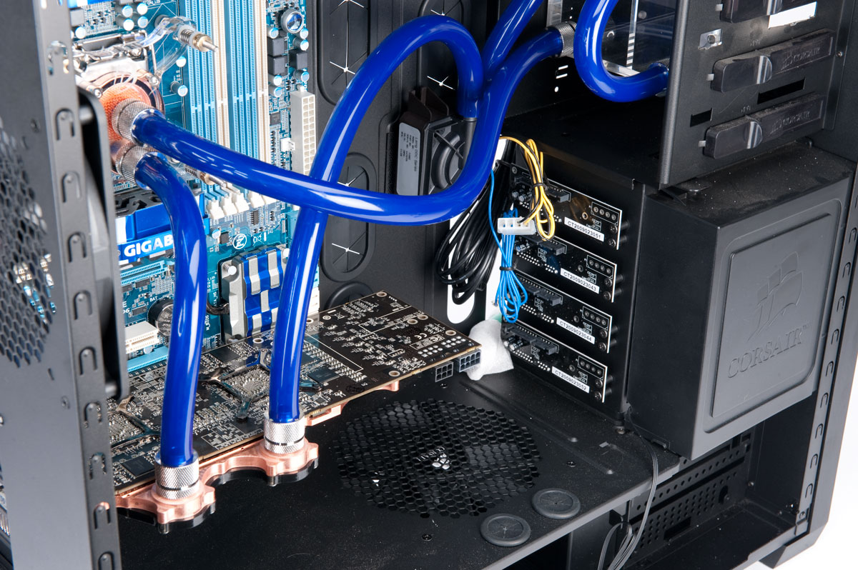
PRODUCTION

Slide 17
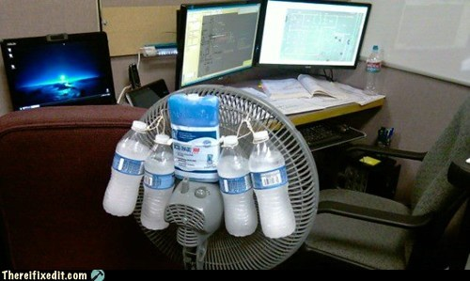
PROTOTYPE

Slide 18

THROWAWAY THAT CODE

Slide 19

PROTUCTION

Slide 20

GLIDE PATH TO RELEVANCY

Slide 21

BOLD CLAIM

Slide 22
BECAUSE REASONS

Slide 23
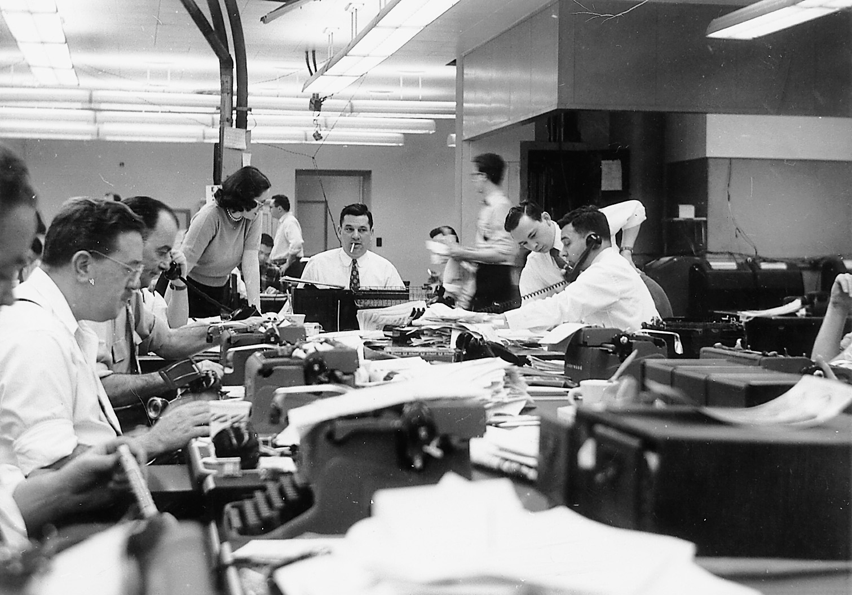
DJANGO WAS BUILT FOR THIS

Slide 24

DJANGO WAS BUILT TO BEND

Slide 25
YOU

Slide 26
BOTTOM LINE

Slide 27

DJANGO TIME

Slide 28
DEVELOPMENT

Slide 29

TWO SCOOPS TASTY

Slide 30

FOREMAN ALSO TASTY

Slide 31
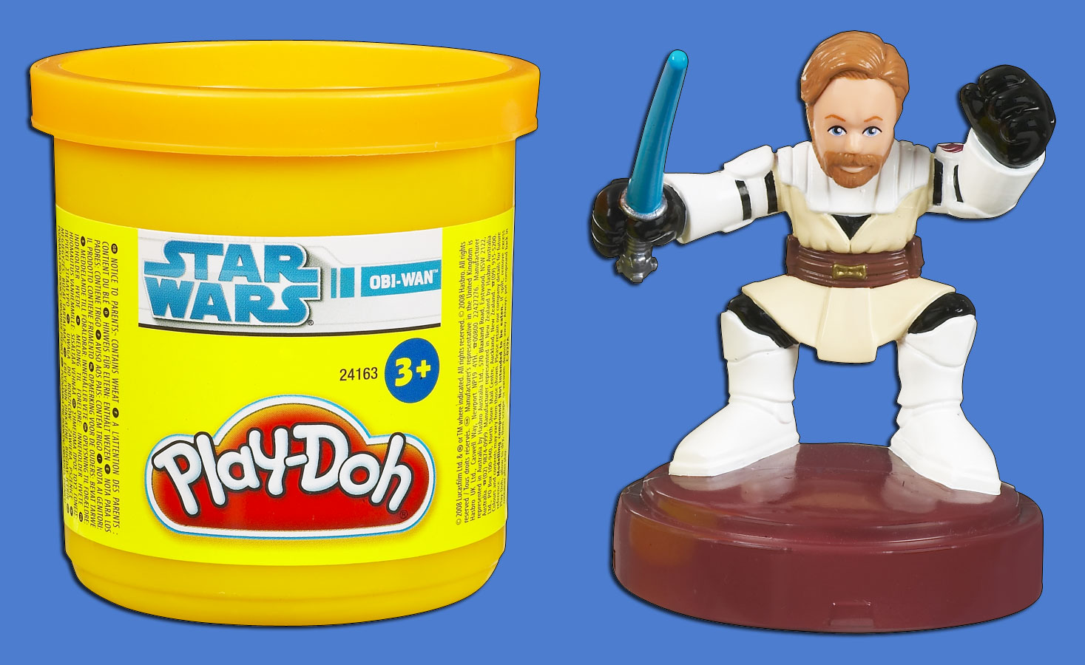
FINALLY STAR WARS

Slide 32
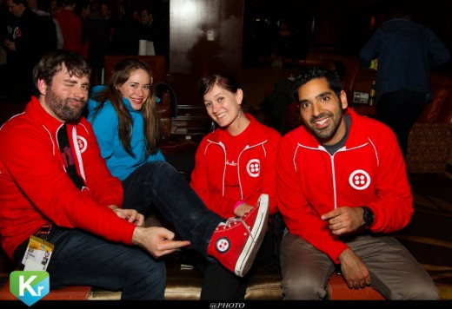
I SEE WHAT YOU DID THERE

Slide 33

FINALLY METAL

Slide 34
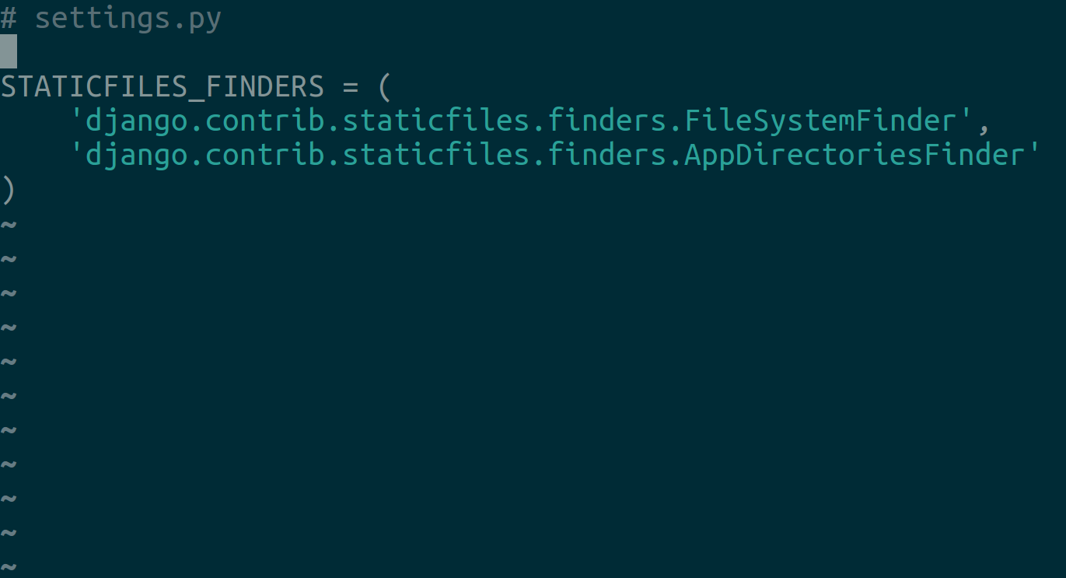
STATICS MADE EASY

Slide 35
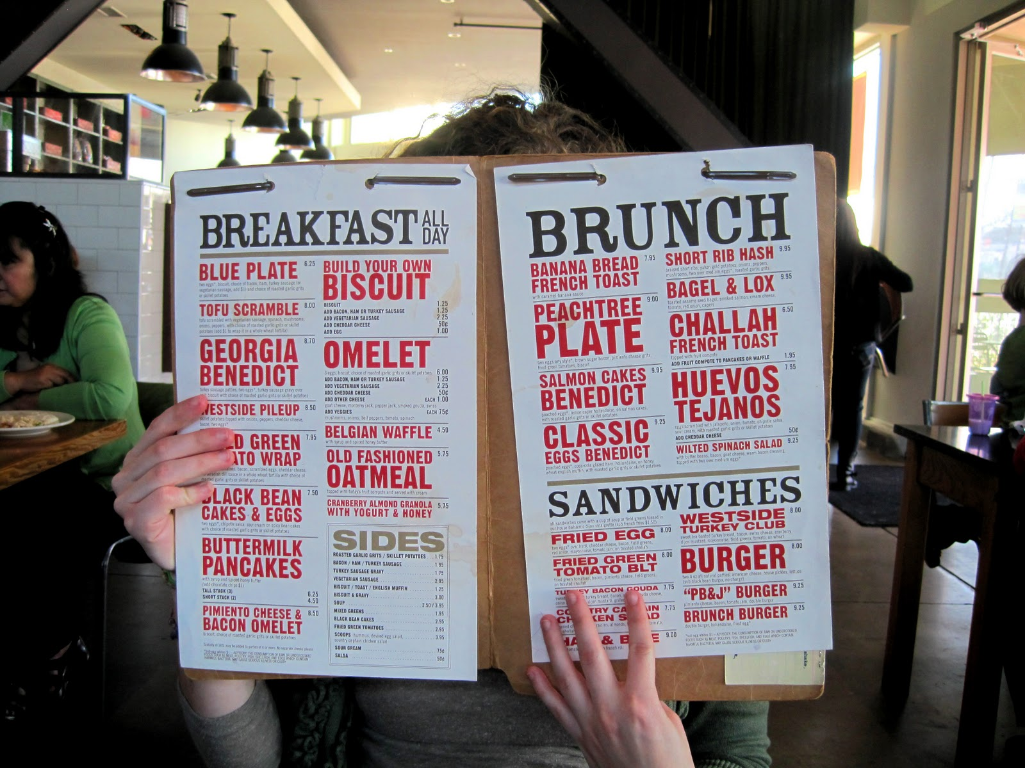
JUST ADD BRUNCH

Slide 36
DEPLOYMENT

Slide 37
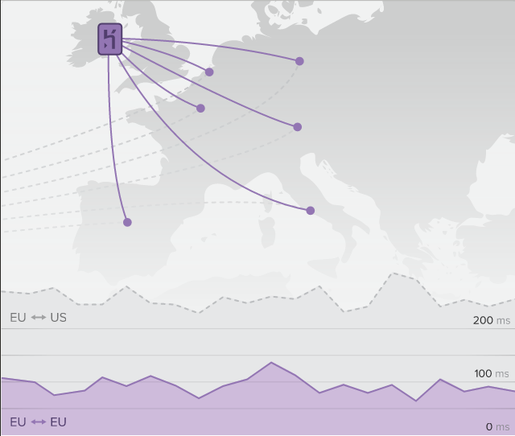
NEW TO THE CONTINENT

Slide 38

SECRET INGREDIENT IS CM

Slide 39

HAMFISTED VISUAL AIDE

Slide 40

'MERICA

Slide 41
API TIME

Slide 42

HAVE A REST

Slide 43
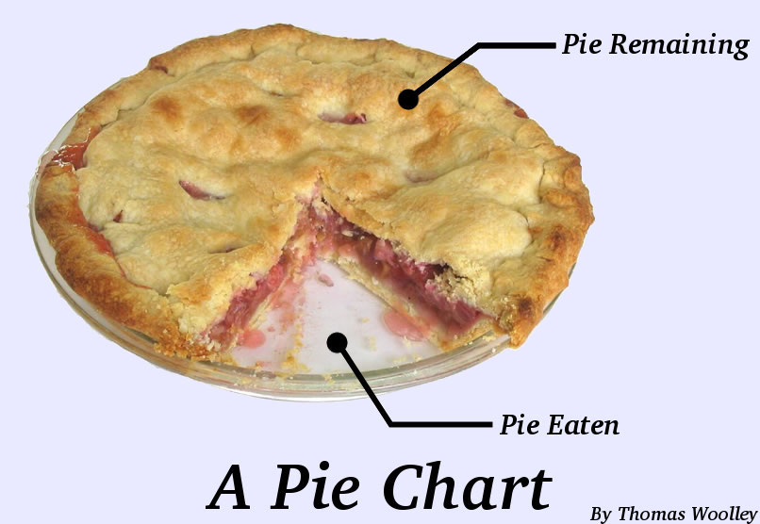
TASTYPIE

Slide 44

NICE GUY

Slide 45

TIGHTLY COUPLED

Slide 46
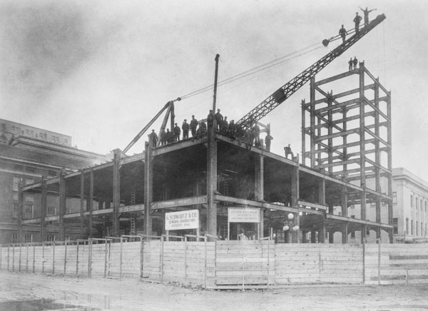
DJANGO REST FRAMEWORK

Slide 47
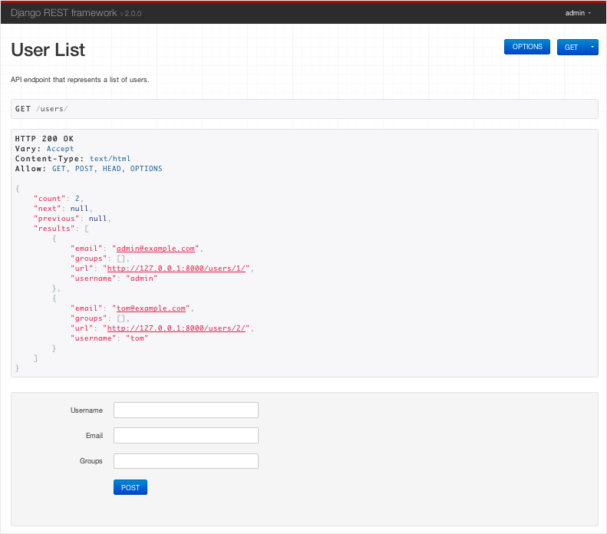
EASILY BROWSEABLE

Slide 48

NICE FEET

Slide 49
SOCIAL AUTH

Slide 50

GOOD LUCK

Slide 51
django-social-login

Slide 52
django-socialprofile

Slide 53
django-socialregistration

Slide 54
django-connect

Slide 55
django-le-social

Slide 56
django-socialauth

Slide 57
django-social-auth

Slide 58

I AM CONFUSED

Slide 59
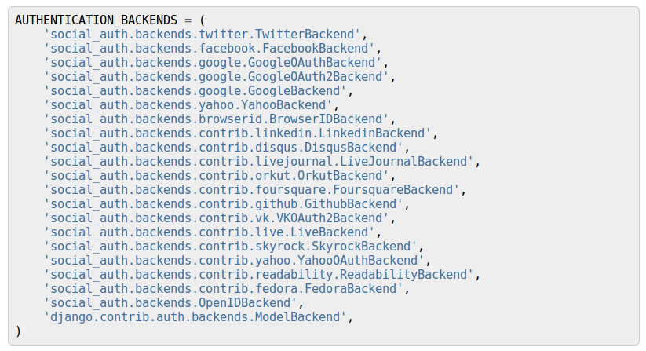
DJANGO-SOCIAL-AUTH

Slide 60

DJANGO-ALLAUTH

Slide 61
SOUTH

Slide 62

RAILER

Slide 63
CELERY

Slide 64

UNFAIR ADVANTAGE

Slide 65
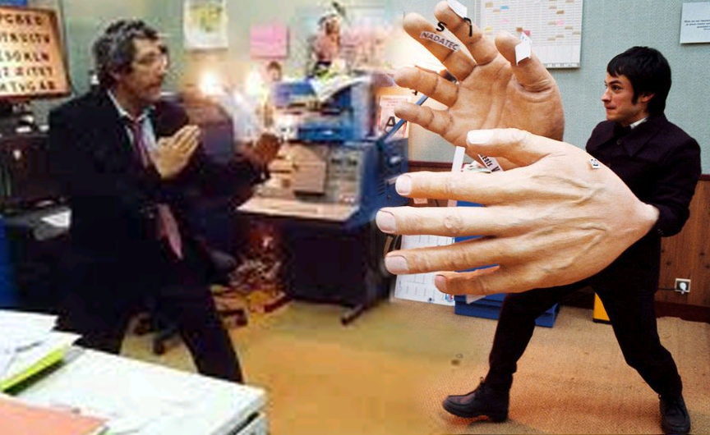
DAUNTING CHALLENGE

Slide 66
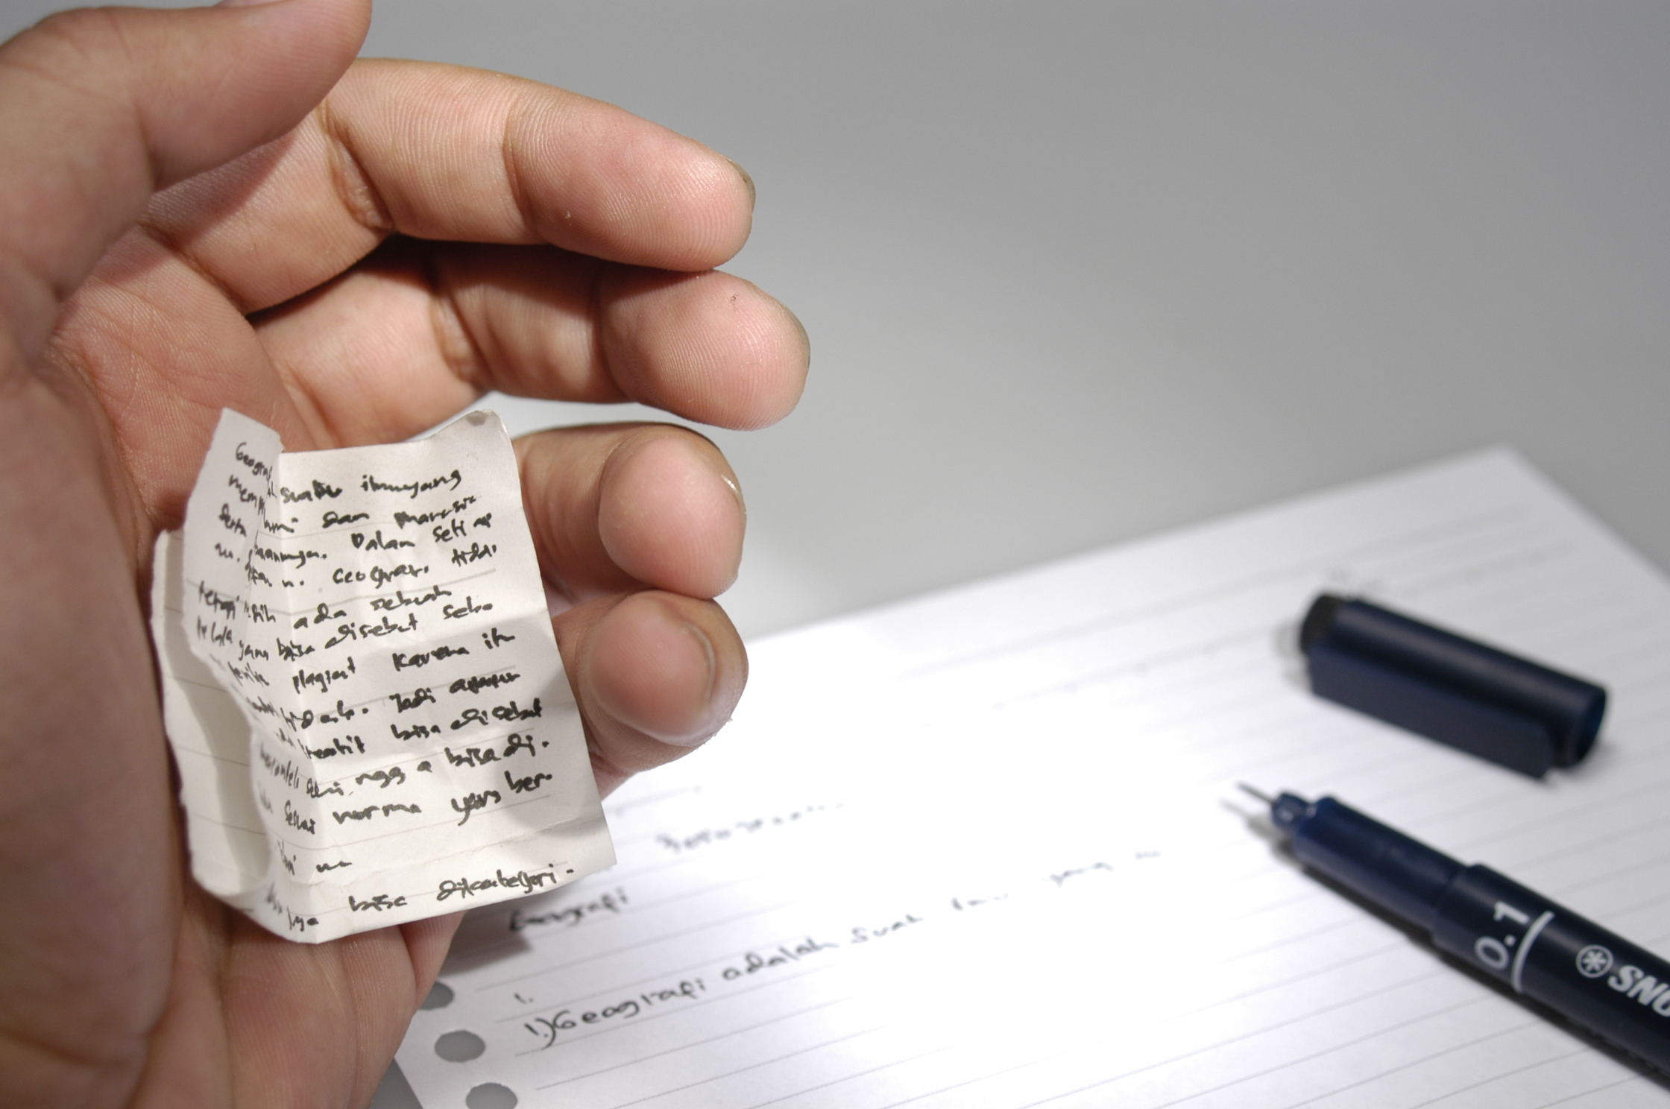
DAUNTING CHALLENGE

Slide 67
SWEDISH FTW

Slide 68
TESTING

Slide 69

WHY?

Slide 70

WHY NOT?

Slide 71

MORE THAN NOSE

Slide 72

BUNDLED WITH ANGULAR

Slide 73
CONCLUSIONS

Slide 74
LET US LEARN

Slide 75
MADE OF WIN

Slide 76

NUMBER ONE

Slide 77
YOU

Slide 78
THANK YOU
Github.com/RobSpectre/Talks
www.brooklynhacker.com
@dN0t – rspectre@twilio.com

